Slide 1

Geometry
Unit 4, Lesson 7 Justifying Congruence Volume 1, pg. 212

Slide 2


Benchmarks
MA.912.GR.2.3 Specify a sequence of transformations that will map a given figure onto itself, or onto another congruent or similar figure.
MA.912.GR.2.6 Apply rigid transformations to map one figure onto another to justify that the two figures are congruent.
volume 1, pg. 212

Slide 3
Integrated Mathematical Thinking and Reasoning Standards
MA.K12.MTR.3.1 Complete tasks with mathematical fluency.
MA.K12.MTR.5.1 Use patterns and structure to help understand and connect mathematical concepts.
MA.K12.MTR.6.1 Assess the reasonableness of solutions.
volume 1, pg. 212

Slide 4

Learning Targets
I can describe a sequence of transformations that will map a preimage and an image to show congruence.
I can describe a sequence of transformations that map one figure onto another congruent figure.
volume 1, pg. 212

Slide 5

Warm-Up
volume 1, pg. 213

Slide 6

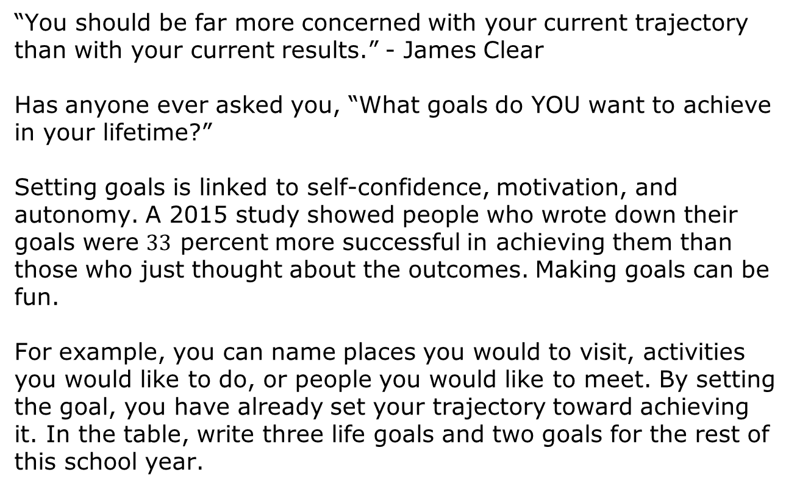
4.7.1 Warm-Up: You Can Do It!
“You should be far more concerned with your current trajectory than with your current results.” - James Clear
Has anyone ever asked you, “What goals do YOU want to achieve in your lifetime?”
Setting goals is linked to self-confidence, motivation, and autonomy. A 2015 study showed people who wrote down their goals were $33$ percent more successful in achieving them than those who just thought about the outcomes. Making goals can be fun.
For example, you can name places you would to visit, activities you would like to do, or people you would like to meet. By setting the goal, you have already set your trajectory toward achieving it. In the table, write three life goals and two goals for the rest of this school year.
volume 1, pg. 213

Slide 7
Life Goals | Goals for this school year
“If you are always trying to be normal, you will never know how amazing you can be.” Maya Angelou
volume 1, pg. 213

Slide 8

Guided Instruction
volume 1, pg. 213

Slide 9
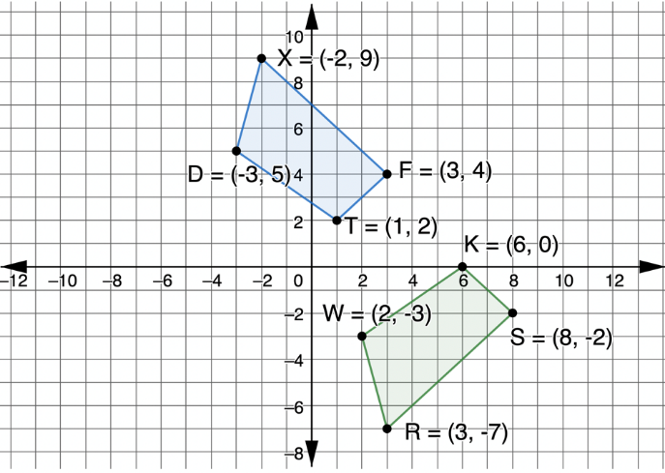
4.7.2 Guided Instruction: Justifying Congruence
Quadrilaterals $XFTD$ and $KSRW$ are shown on the coordinate plane.
Describe a sequence of transformations that will map quadrilateral $KSRW$ onto quadrilateral $XFTD.$
volume 1, pg. 213

Slide 10


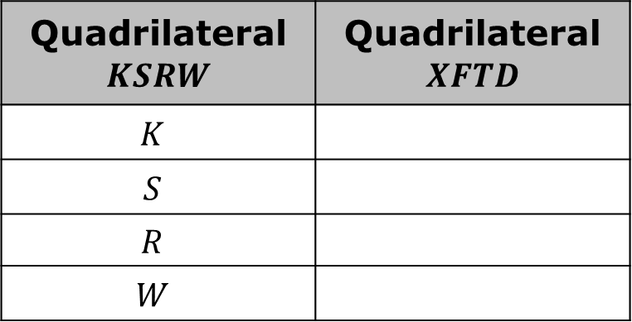
Complete the table that shows which vertices were mapped to each other when quadrilateral $KSRW$ was mapped onto quadrilateral $XFTD.$
Quadrilateral $KSRW$ | Quadrilateral $XFTD$
$$K$$
$$S$$
$$R$$
$$W$$
Definition of Congruence in Terms of Rigid Motions
Two figures are congruent if and only if there exists one or more rigid motions, which will map one figure onto the other.
volume 1, pg. 214

Slide 11
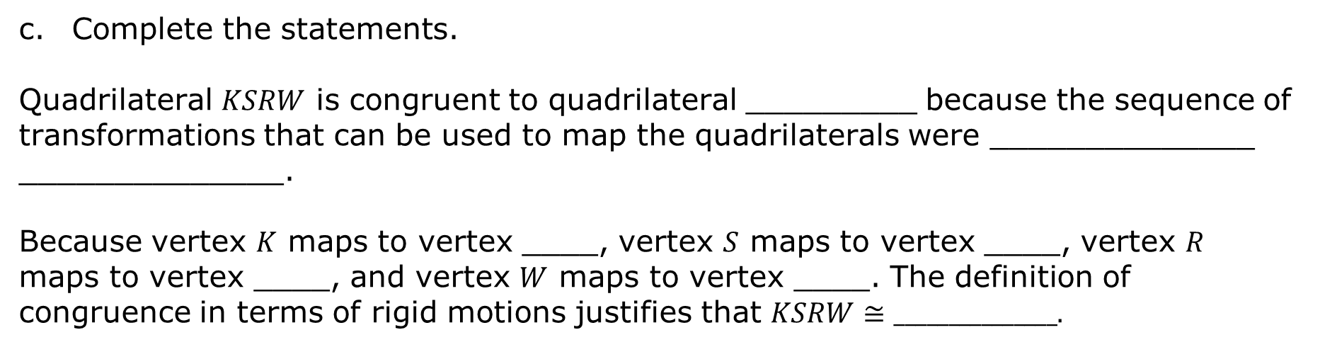
Complete the statements.
Quadrilateral $KSRW$ is congruent to quadrilateral _________ because the sequence of transformations that can be used to map the quadrilaterals were ______________ ______________.
Because vertex $K$ maps to vertex ____, vertex $S$ maps to vertex ____, vertex $R$ maps to vertex ____, and vertex $W$ maps to vertex ____. The definition of congruence in terms of rigid motions justifies that $KSRW≅_______________.$
volume 1, pg. 214

Slide 12
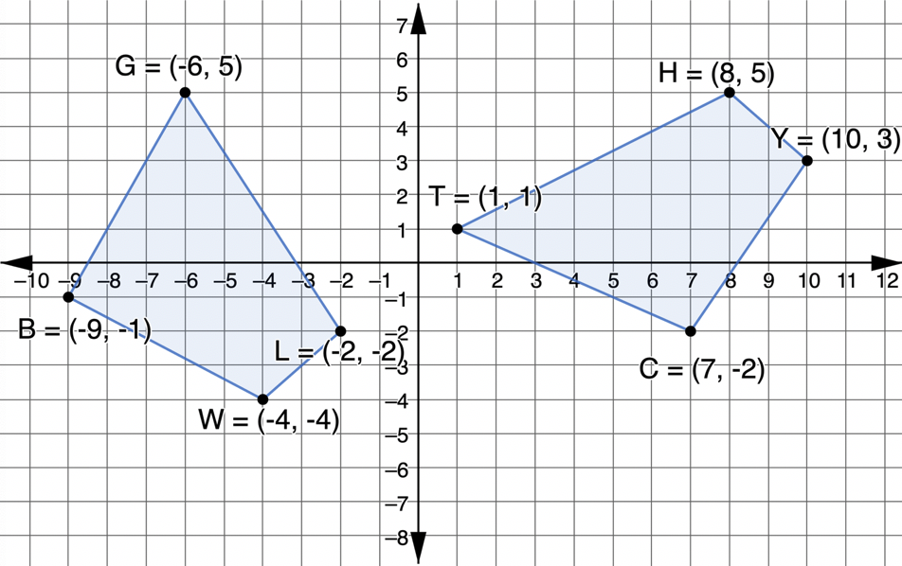
Quadrilaterals $BGLW$ and $HYCT$ are shown on the coordinate plane.
Use algebraic descriptions to describe a sequence of transformations that will map quadrilateral $BGLW$ onto quadrilateral $HYCT.$
volume 1, pg. 214

Slide 13
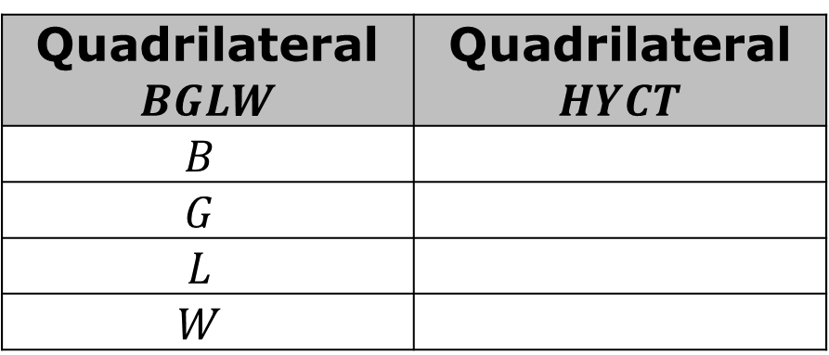
Complete the table that shows which vertices were mapped to each other when quadrilateral $BGLW$ was mapped onto quadrilateral $HYCT.$
Quadrilateral $BGLW$ | Quadrilateral $HYCT$
$$B$$
$$G$$
$$L$$
$$W$$
volume 1, pg. 214

Slide 14

When using rigid motions to map one figure onto the other, always be sure the corresponding vertices match before stating congruence.
Complete the congruence statement.
$$BGLW≅_____________$$
volume 1, pg. 215

Slide 15

Guided Practice
volume 1, pg. 215

Slide 16

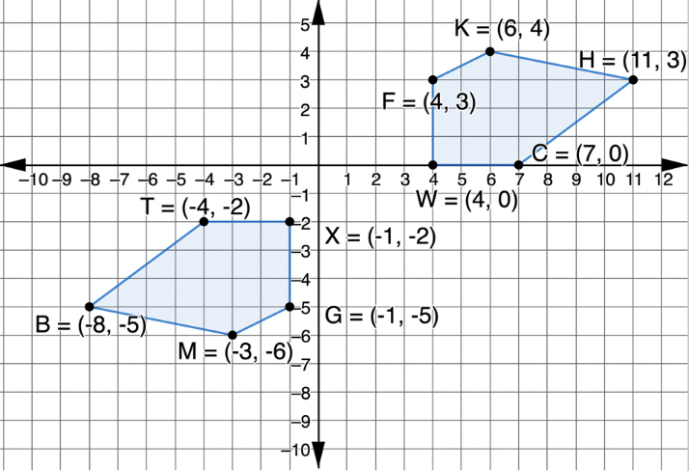

4.7.3 Guided Practice: Justifying Congruence
Polygons $TXGMB$ and $WFKHC$ are shown on the coordinate grid.
Use algebraic descriptions to describe a sequence of transformations that will map polygon $TXGMB$ onto polygon $WFKHC$.
Complete the congruence statement.
$TXGMB≅_____________$
volume 1, pg. 215

Slide 17
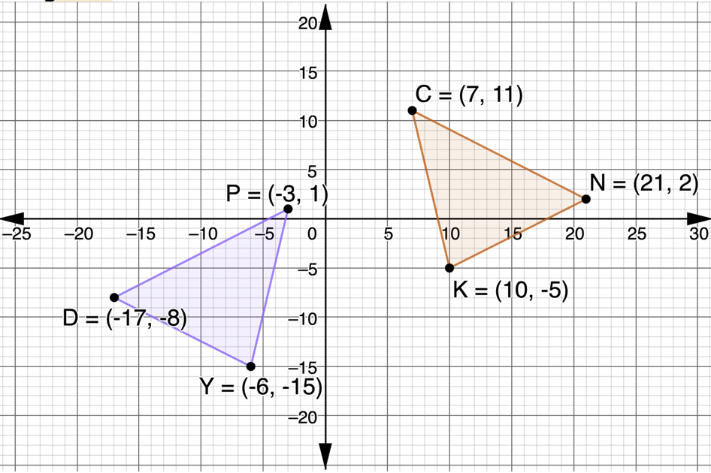
2. Triangles $CKN$ and $PYD$ are shown on the coordinate grid.
volume 1, pg. 216

Slide 18


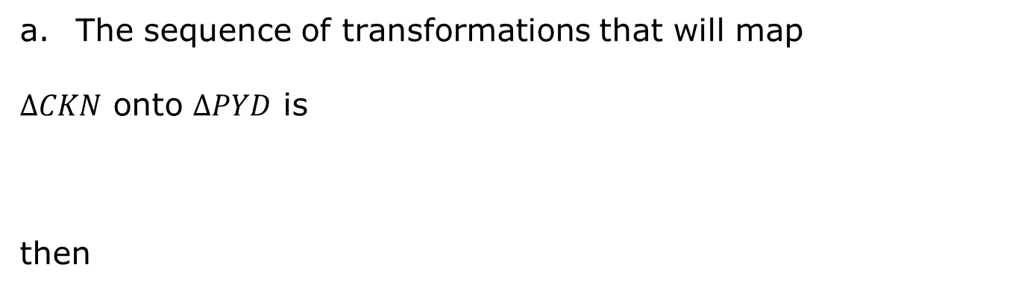

The sequence of transformations that will map
$∆CKN$ onto $∆PYD$ is
then
Vertex $C$ maps to vertex ____, vertex $K$ maps to vertex ____, and vertex $N$ maps to vertex ____ therefore $∆CKN$ is congruent to $∆_________$ by the definition of congruence in terms of rigid motions.
volume 1, pg. 216

Slide 19

Your Turn
volume 1, pg. 216

Slide 20
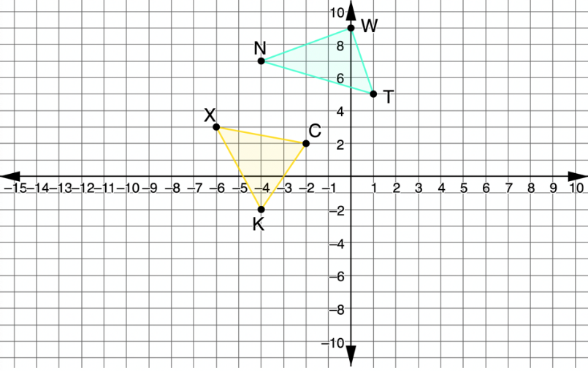
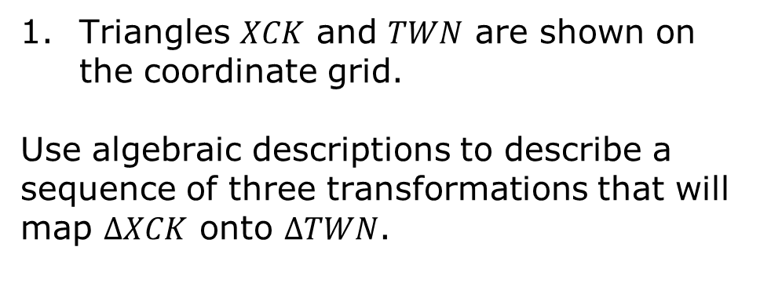
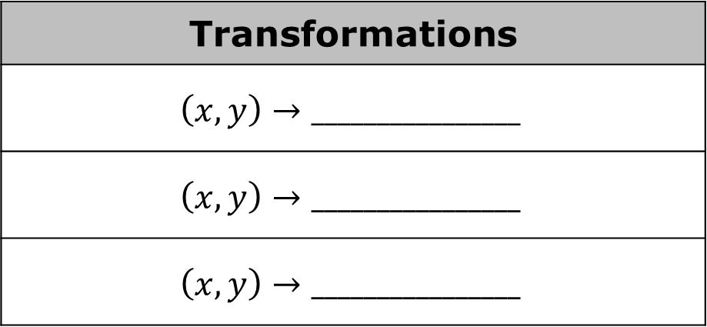
4.7.4 Your Turn!
Triangles $XCK$ and $TWN$ are shown on the coordinate grid.
Use algebraic descriptions to describe a sequence of three transformations that will map $∆XCK$ onto $∆TWN$.
Transformations
$$\left(x,y\right)→________________$$
$$\left(x,y\right)→________________$$
$$\left(x,y\right)→________________$$
volume 1, pg. 216

Slide 21

Wrap-Up
volume 1, pg. 217

Slide 22
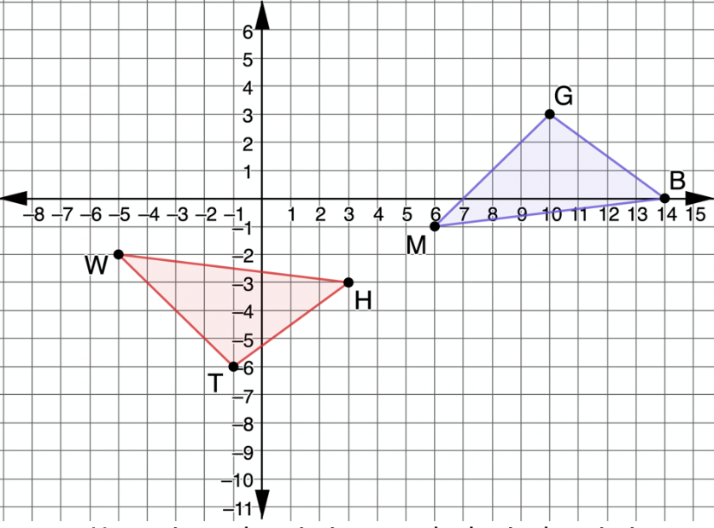
4.7.5 Wrap-Up: Ticket Out the Door
Triangles $TWH$ and $GBM$ are shown on the coordinate grid.
volume 1, pg. 217

Slide 23
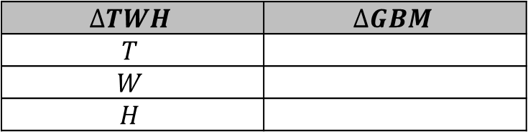

Use written descriptions or algebraic descriptions to describe a sequence of two transformations that will map the two triangles onto each other.
Complete the table that shows which vertices were mapped to each other.
$$∆TWH$$ | $$∆GBM$$
$$T$$
$$W$$
$$H$$
Complete the congruence statement.
$$∆TWH≅_____________$$
volume 1, pg. 217

